Slide 1
DATA MINING
SEED CLUSTERING
ABDULLAH SAKA

Slide 2


OUTLINE
My focus in this project was to gain experience in variety of wheat
Solving clustering problem by using
k-means and
hierarchical clustering
Implementation in R Studio
The goal: build a clustering model that identifies groups of “wheat” are similar to each other

Slide 3

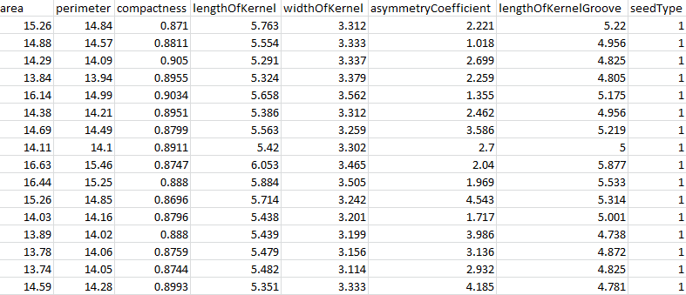
DATASET
7 variables / 210 records
Class of attribute: Numeric
area A,
perimeter P,
compactness C = 4piA/P^2,
length of kernel,
width of kernel,
asymmetry coefficient
length of kernel groove.
seedtype(not used in clustering)

Slide 4
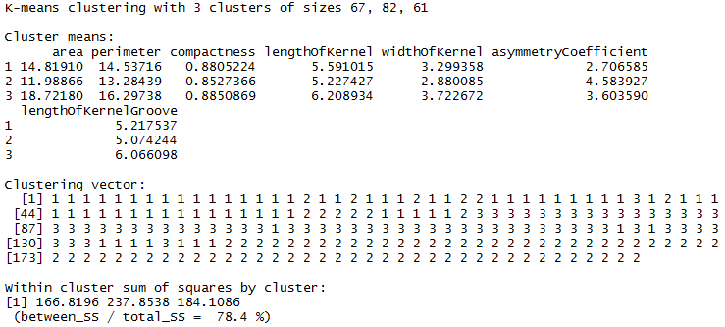

K-MEANS CLUSTERING
Imported dataset into R,
Checked whether dataset includes “NA” values,
Eliminated irrevalant data columns to ease process.
Use seed() to reproduce same result
Apply kmeans() function to create clustering
Try different k values such as 3,4,5,6
PRE-PROCESSING
PROCESSING

Slide 5
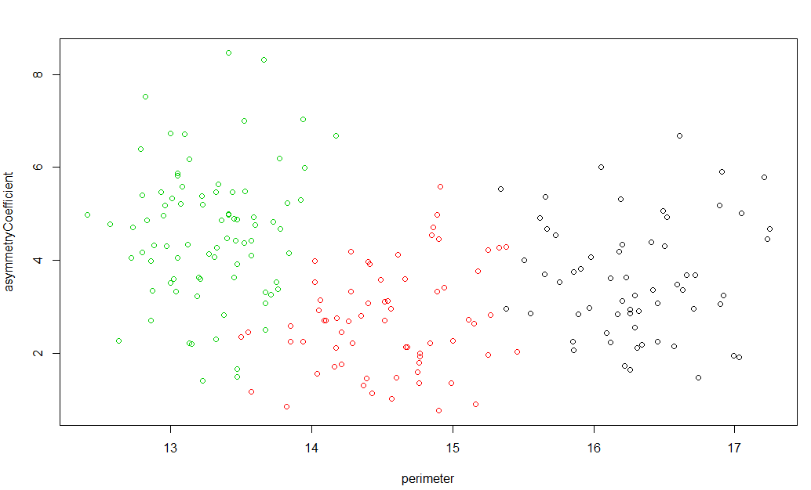
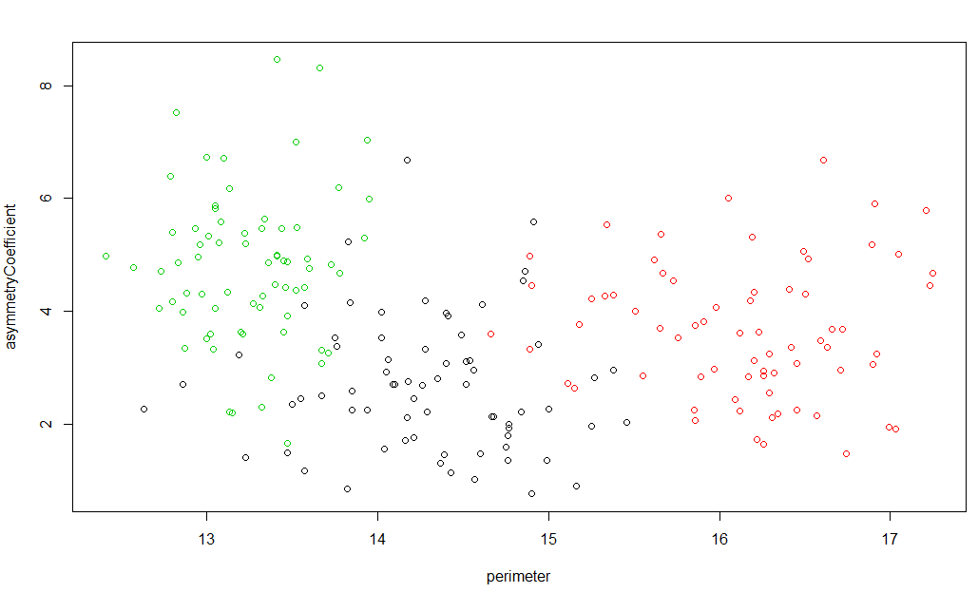
K-MEANS CLUSTERING
ACTUAL
CLUSTERING MODEL

Slide 6
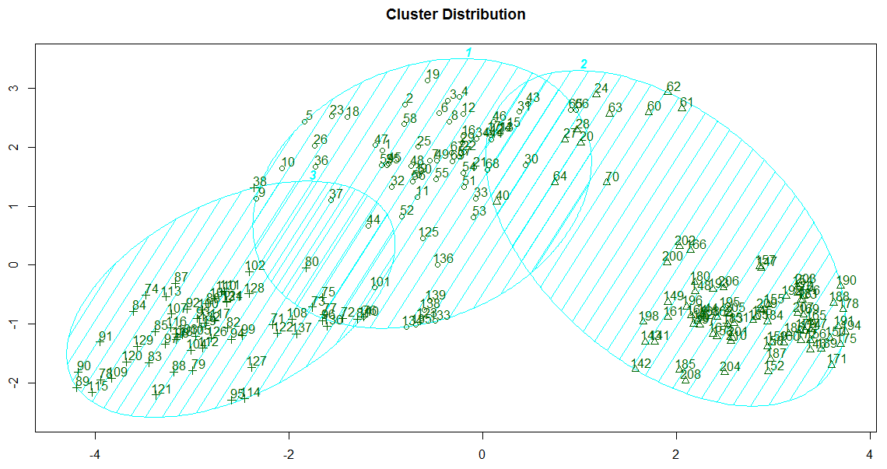
K-MEANS CLUSTERING

Slide 7
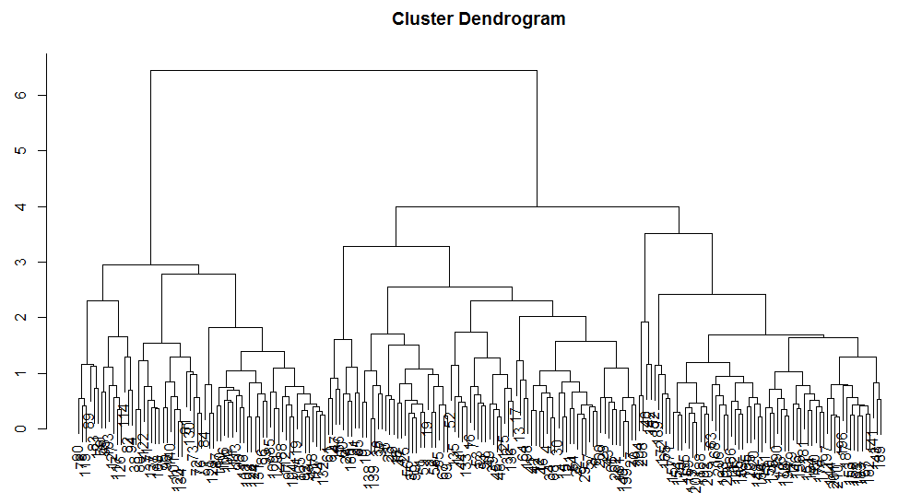
HIERARCHICAL CLUSTERING
Imported dataset into R,
Checked whether dataset includes “NA” values,
Eliminated irrevalant data columns to ease process.
Use seed() to reproduce same result
Apply kmeans() function to create clustering
PRE-PROCESSING
PROCESSING

Slide 8
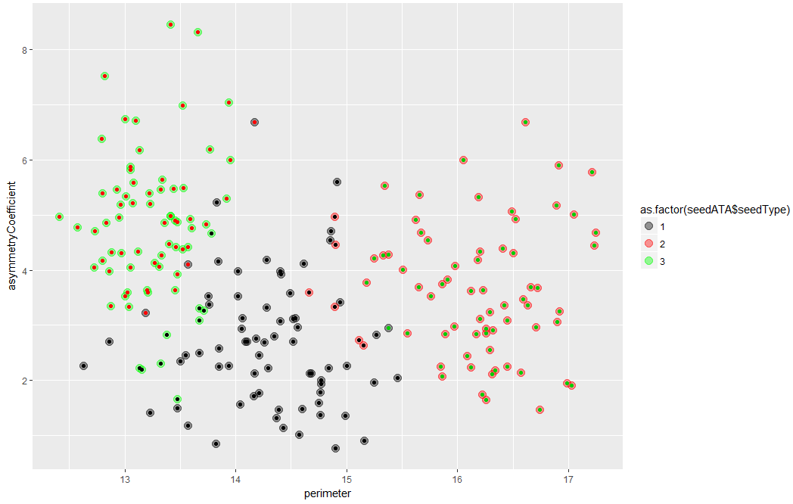
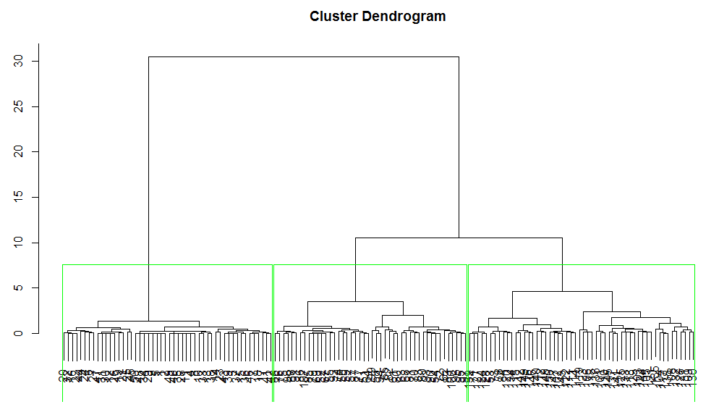
HIERARCHICAL CLUSTERING

